Slide 1
The Internal Environment

Slide 2
Four broad areas need to be considered for internal analysis
The organisation’s resources, capabilities.
The way in which the organisation co-ordinates its key value-adding activities.
The structure of the organisation and the characteristics of its culture.
The performance of the organisation as measured by the strength of its products.

Slide 3
Internal analysis
Analysis of the global business
Global value chain analysis: configuration and co-ordination
Resources, capabilities and core competences
Cultural and structural analysis
Global products and performance

Slide 4
External and Internal Analyses
By studying the internal environment, firms identify what they can do.
Unique resources, capabilities, and core competencies
(sustainable competitive advantage).
The Firm

Slide 5
Challenge of Internal Analysis
How do we effectively manage current core competencies while simultaneously developing new ones?
How do we assemble bundles of resources, capabilities and core competencies to create value for customers?
How do we learn to change rapidly?

Slide 6
Conditions Affecting Managerial Decisions About Resources, Capabilities, and Core Competencies
Uncertainty regarding characteristics of the general and the industry environments, competitors’ actions, and customers’ preferences
Complexity regarding the interrelated causes shaping a firm’s environments and perceptions of the environments
Intraorganizational Conflicts among people making managerial decisions and those affected by them

Slide 7
Mission Statement
A corporate mission statement is a means of reminding everybody within the organisation of its essential purpose.
Drucker (1973) identified some questions that managers should ask themselves when the organisation is lacking of a purpose:
What is our business?
Who is the customer?
What is the value to the customer?
What will our business be?
What should our business be?

Slide 8
Mission statement is a reflection of a number of factors:
The organisation’s ownership, which can lead to contrasts in the mission statements of public-sector, private sector and charity organisations.
The previous history of the organisation, in particular any distinct competencies it has acquired or images it has created in the eyes of potential customers.
Environmental factors, in particular the major opportunities and threats that are likely to face the organisation in the foreseeable future.
Resources available – without resources available for its accomplishment, a mission statement has little meaning.

Slide 9
Organisational (Corporate) Culture
Organisational (corporate) culture is a pattern of basic assumptions that are considered valid and that are taught to new members as the way to:
perceive,
think, and
feel in the organisation.
Notes:
2

Slide 10
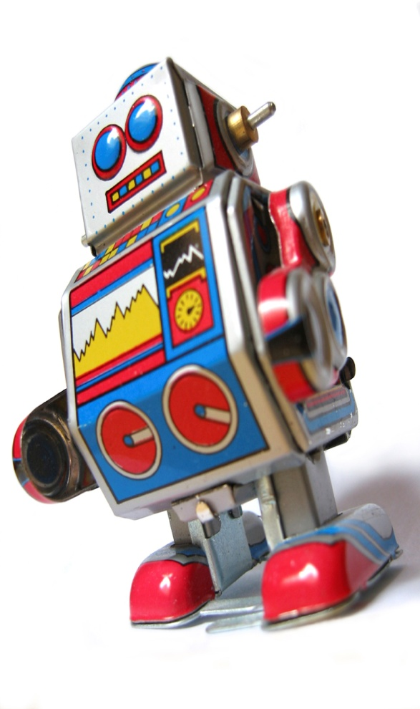
Functions of Organisational Culture
Culture serves four functions, including:
Providing a sense of identity to members and promoting a sense of commitment.
Helps members attribute sense and meaning to events,
Reinforces the values in the organisation.
Finally, culture serves as a control mechanism for shaping behaviour.

Slide 11
Culture values can be shared in a number of ways, including:
The way work is organised and experienced.
How authority is exercised and delegated.
How people are rewarded, organised and controlled.
The values and work orientated staff.
The degree of formalisation, standardisation and control within the organisation.
The value placed on structured processes of planning, analysis and control, rather than instinct and gut feeling.
How much initiative, risk-taking, scope for individuality and expression is given.

Slide 12
Resources
Resources are assets employed in the activities and processes of the organisation.
They can be tangible or intangible.
They can be obtained externally or internally generated.
They can be specific and non-specific:
Specific resources can only be used for highly specialised purposes and are very important to the organisation in adding value to goods and services.
Assets that are less specific are less important in adding value, but are more flexible.

Slide 13
Resources fall within several categories:
Human
Financial
Physical
Technological
Informational

Slide 14
General Competences/capabilities
They are assets like industry-specific skills, relationships and organisational knowledge which are largely intangible and invisible assets.
Competences and capabilities will often be internally generated, but may be obtained by collaboration with other organisations.
Certain competences are likely common to competing businesses within a global industry or strategic group.

Slide 15
Core Competences/Distinctive Capabilities
Core competences are combinations of resources and capabilities which are unique to a specific organisation and which are responsible for generating its competitive advantage.
Kay (1993) identified four potential sources of Core competences:
Reputation
Architecture (i.e., internal and external relationship)
Innovation
Strategic assets

